Slide 1
Topological Sort
27 June 2025

Slide 2
DFS for Topological Sort

Slide 3

Learn by Doing – Build Dependencies
Task – Build Dependencies – Link.
Read the task, then we investigate algorithm.

Slide 4
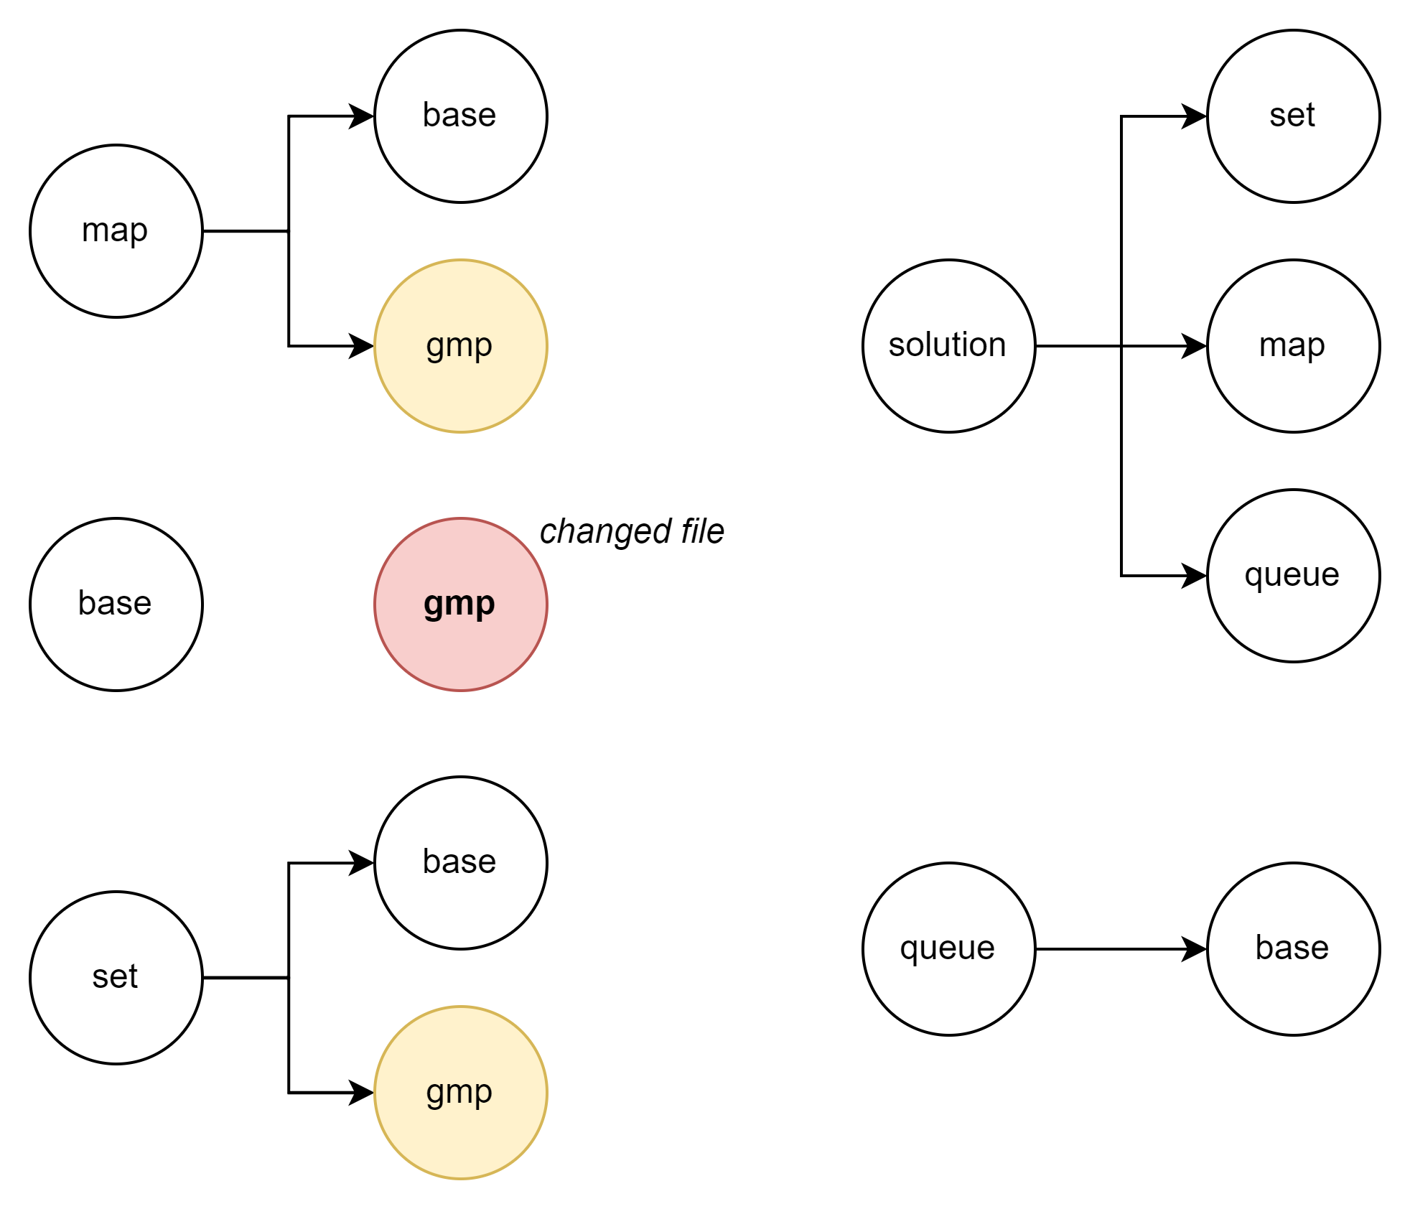
Problem Visualization

Slide 5
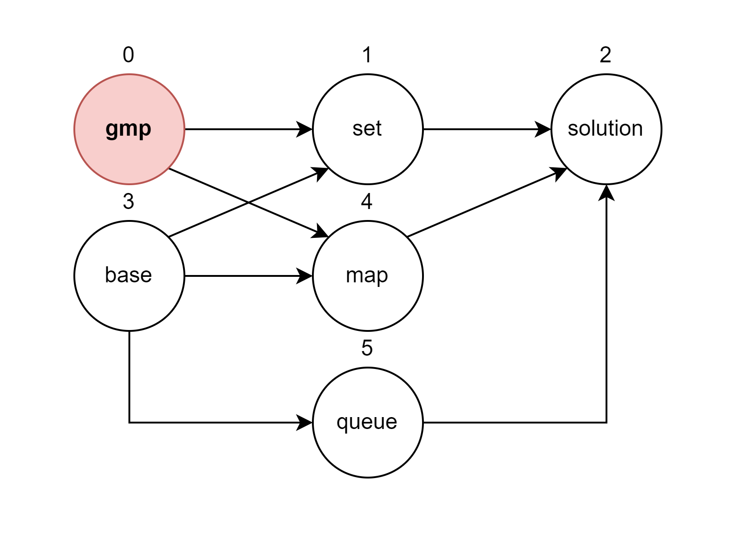
DFS to Solve Problem

Slide 6
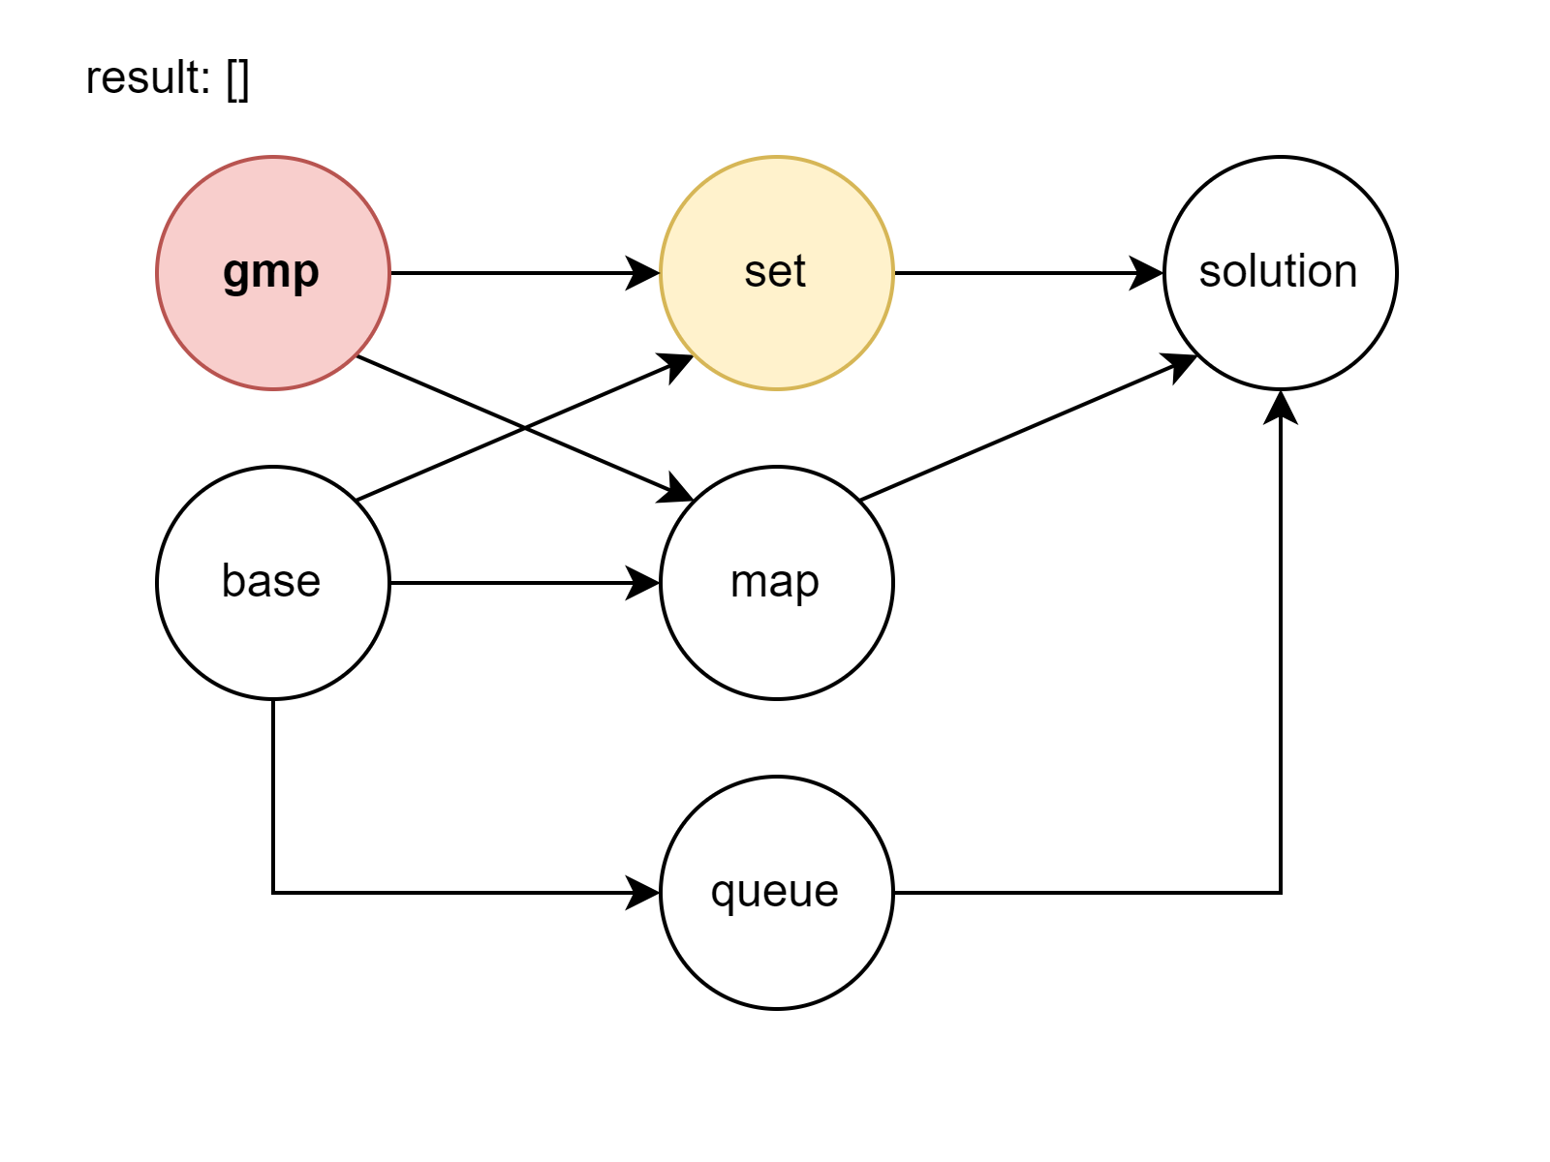
DFS to Solve Problem

Slide 7
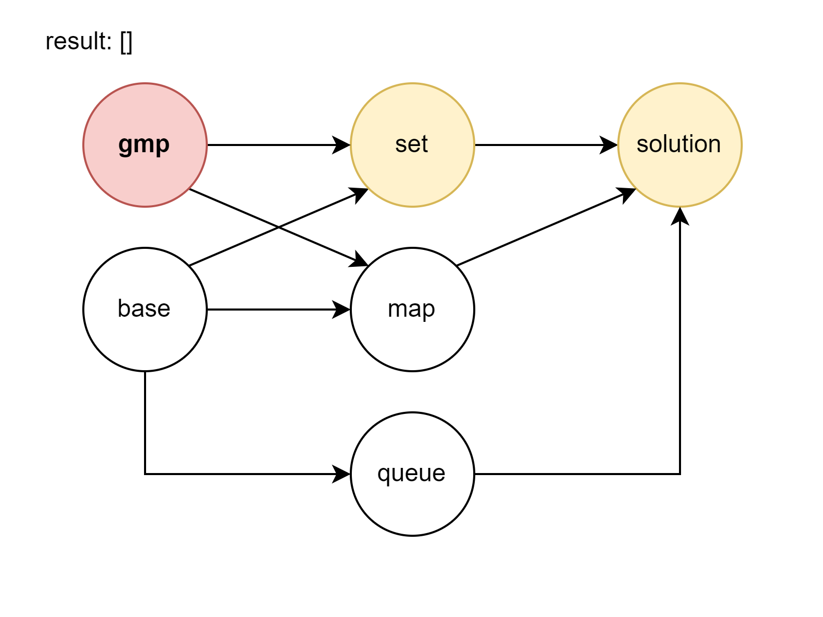
DFS to Solve Problem

Slide 8
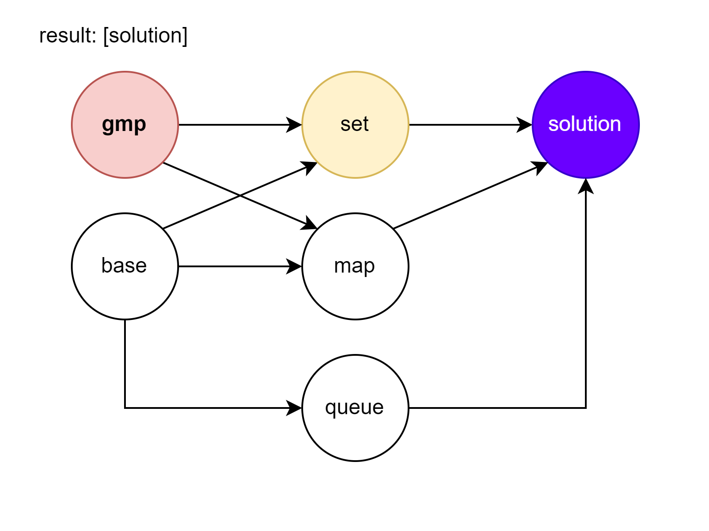
DFS to Solve Problem

Slide 9
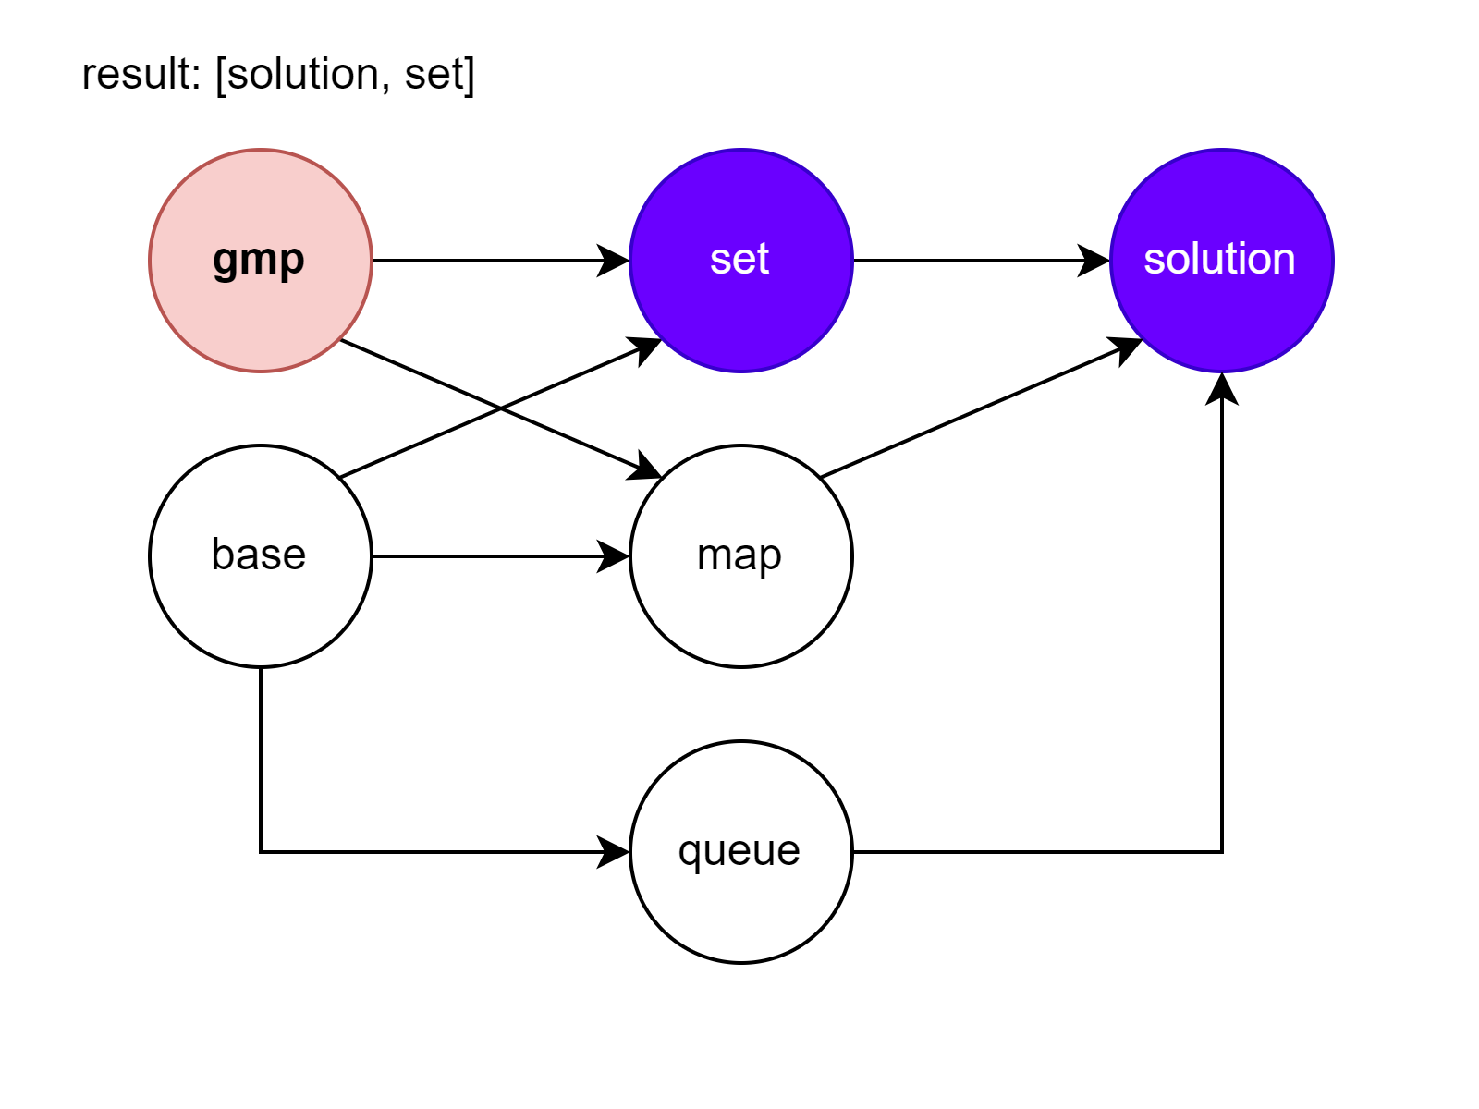
DFS to Solve Problem

Slide 10
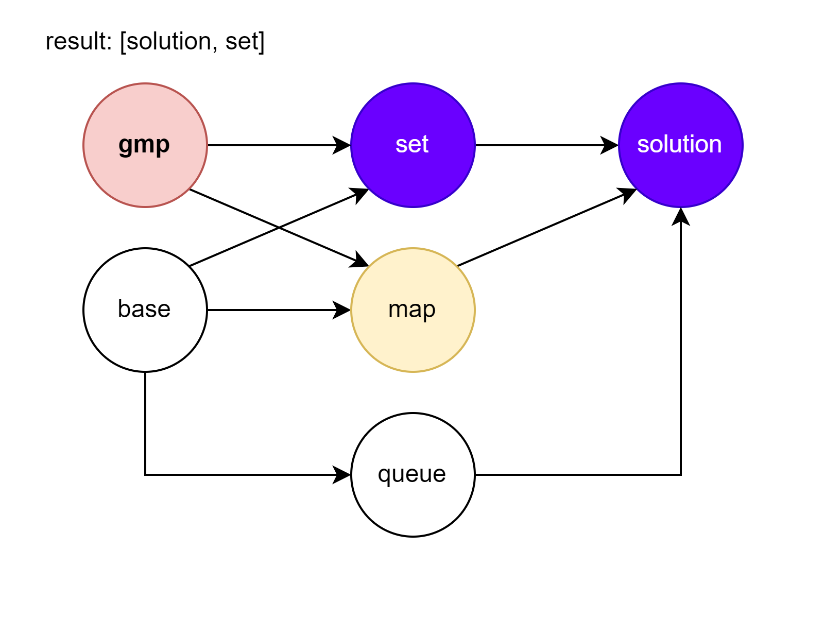
DFS to Solve Problem

Slide 11
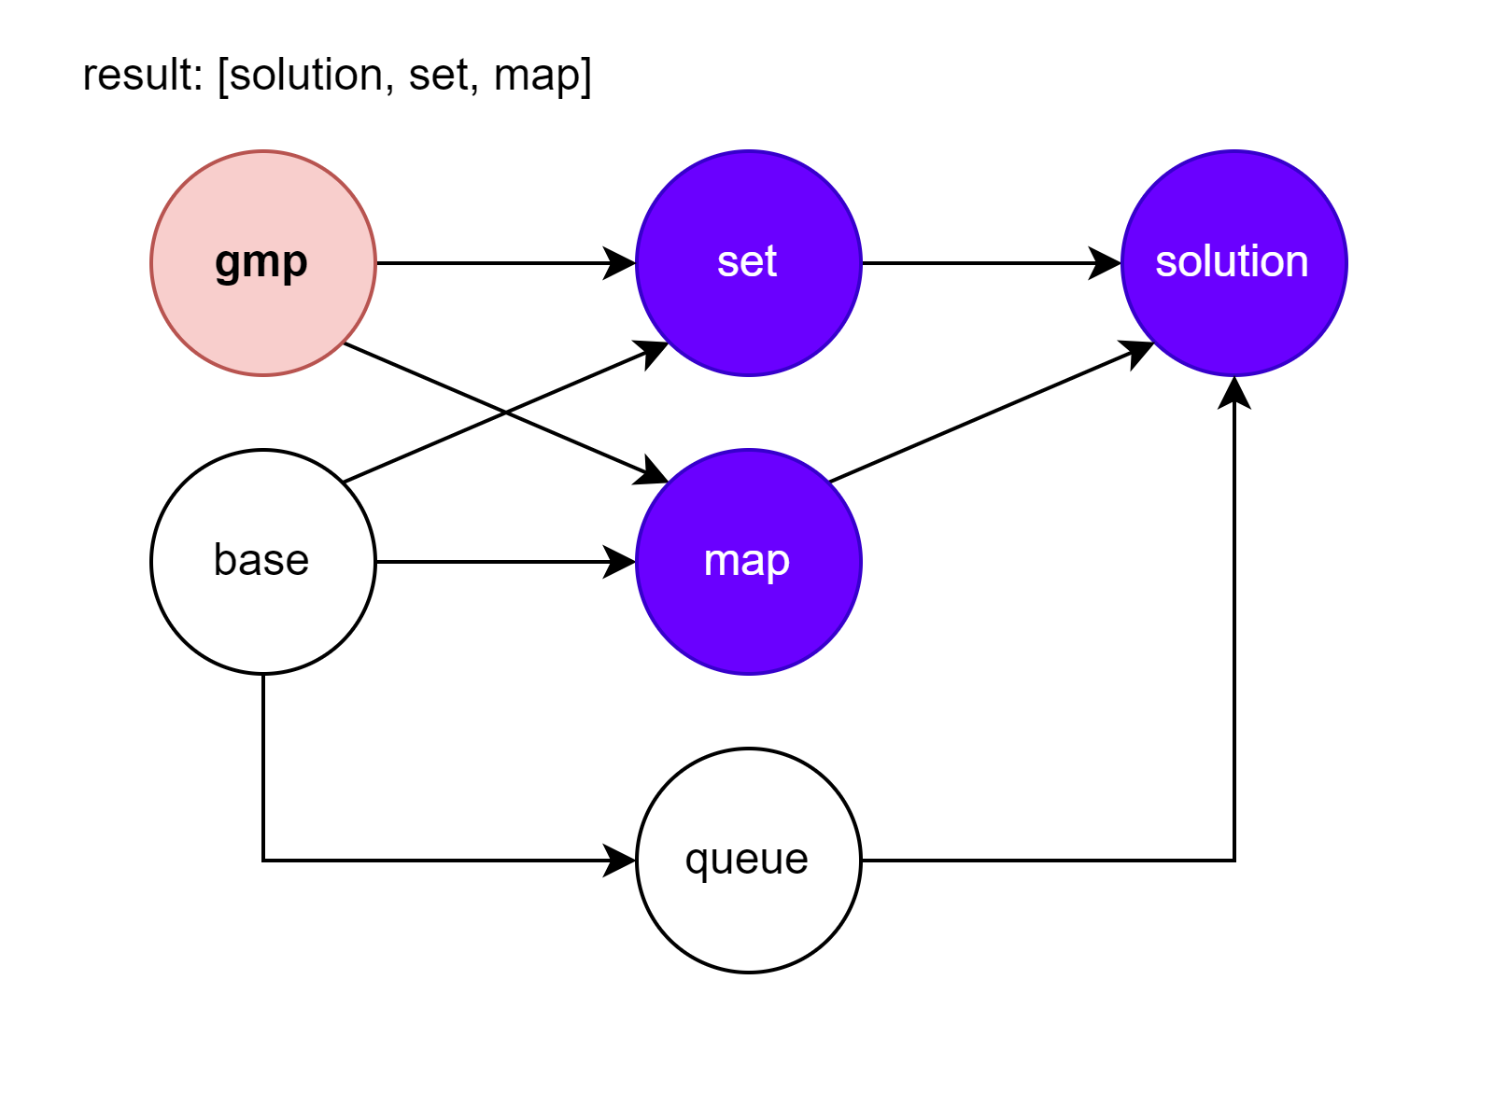
DFS to Solve Problem

Slide 12
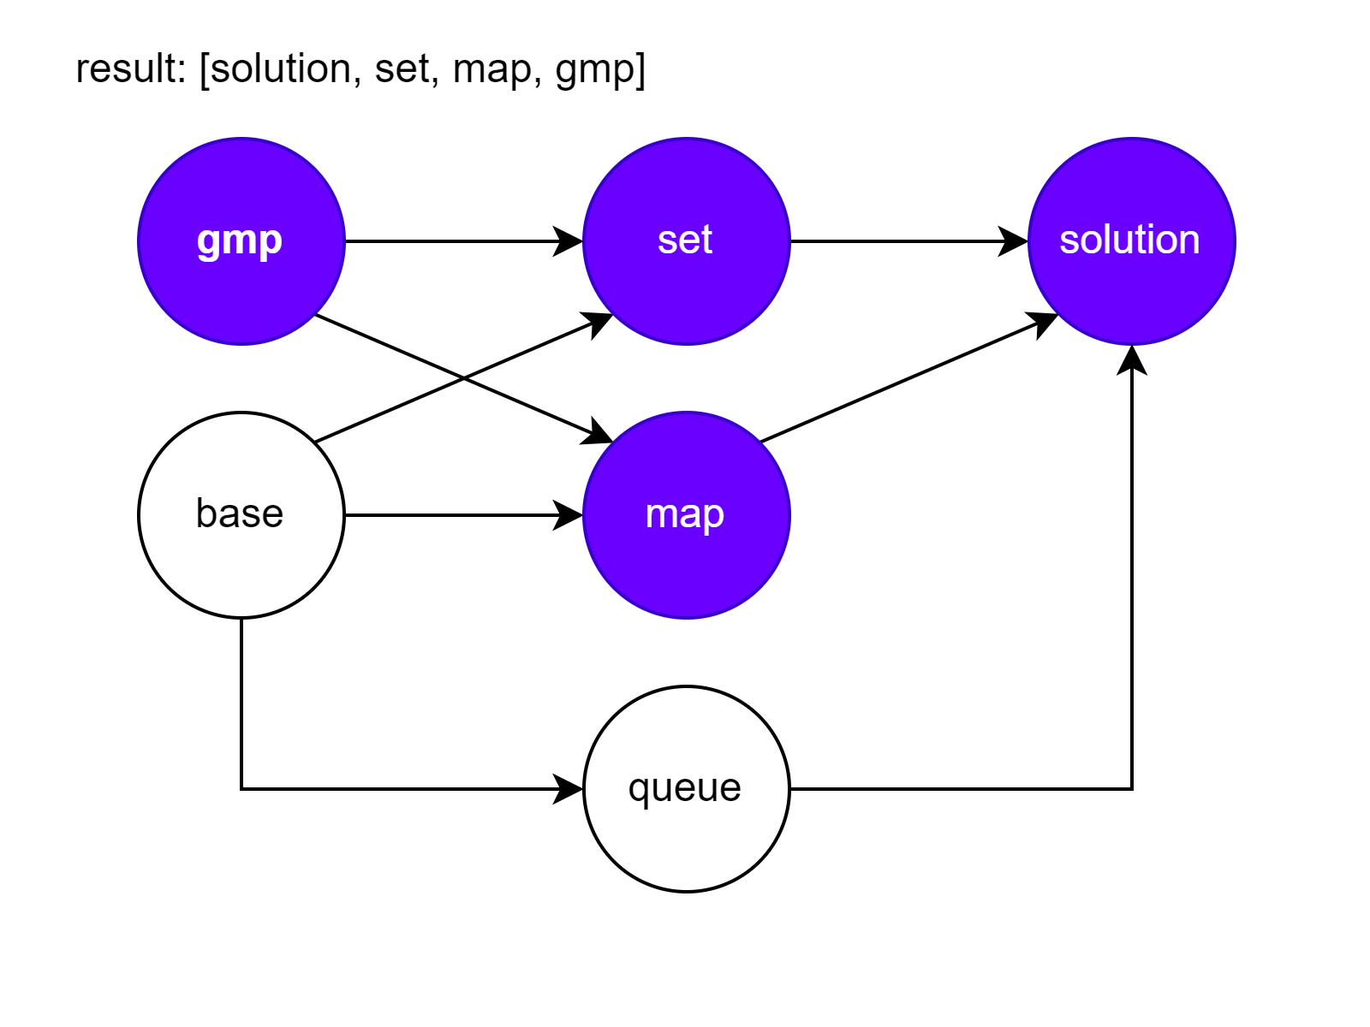
DFS to Solve Problem

Slide 13
Learn by Doing
Task – Build Dependencies – Link.
Time to solve the task!

Slide 14
Learn by Doing
Task – Brexit – Link.
Read the task, then we investigate algorithm.

Slide 15
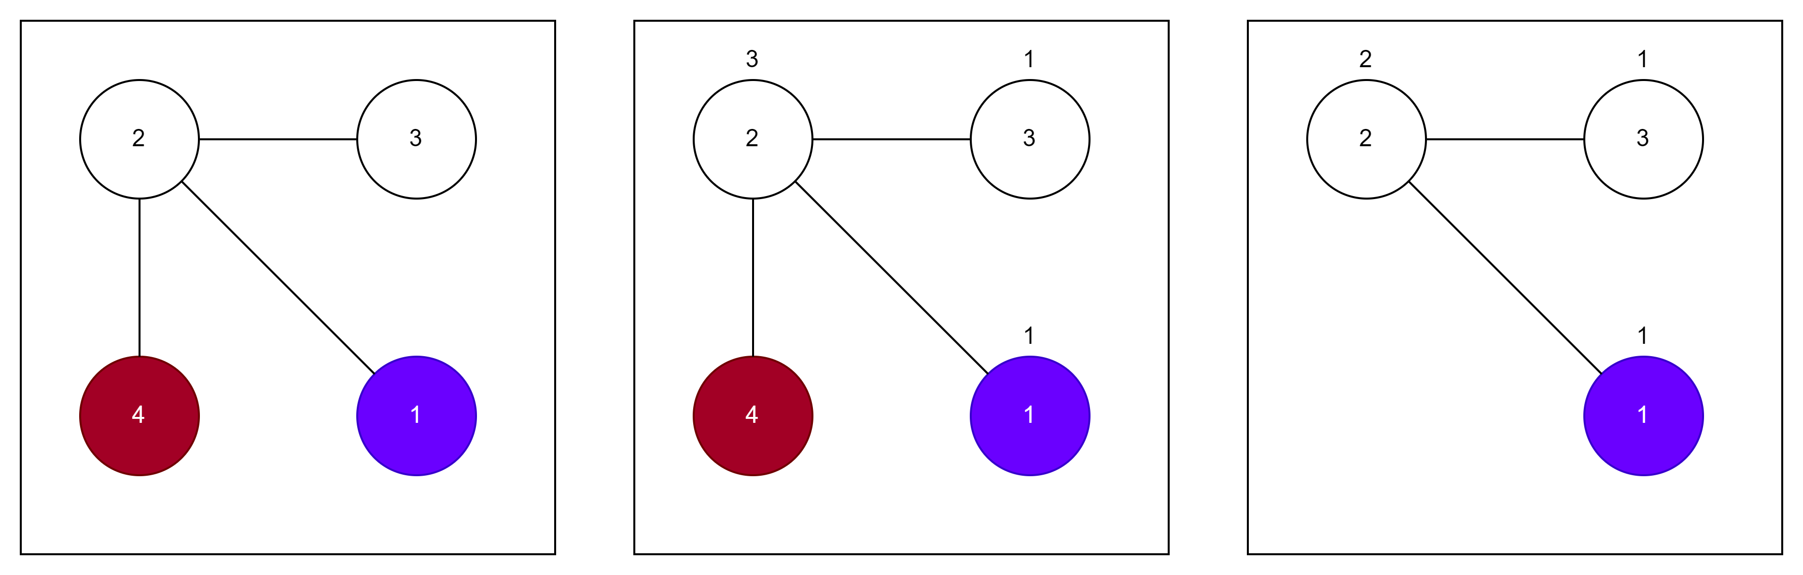
Kahn’s Algorithm – Example 1

Slide 16
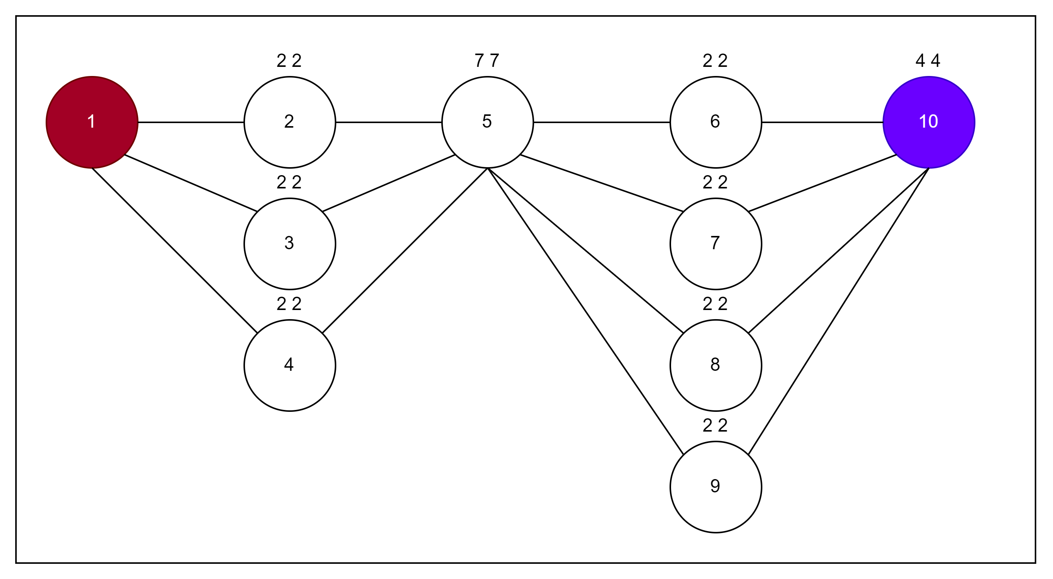
Kahn’s Algorithm – Example 2

Slide 17
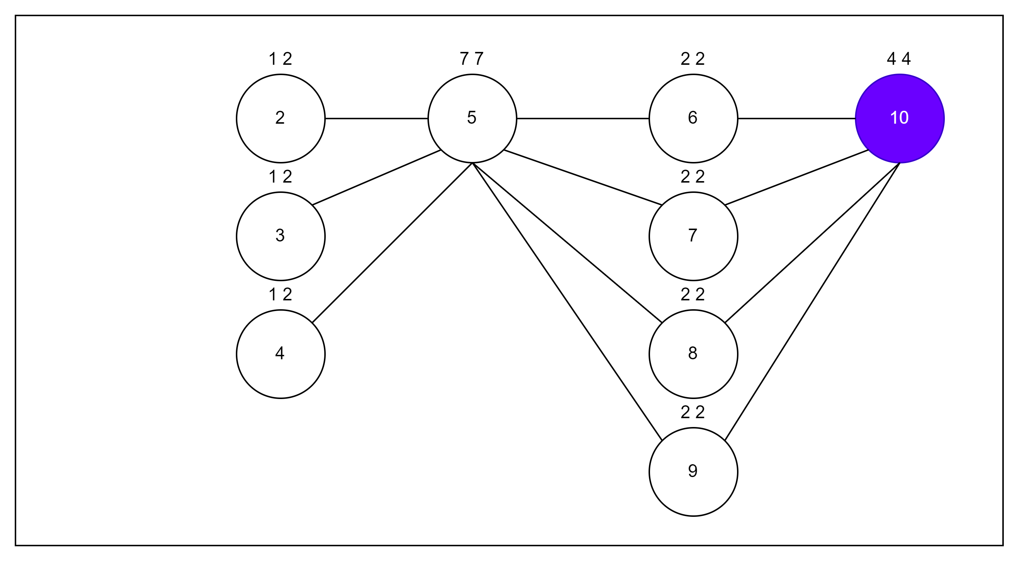
Kahn’s Algorithm – Example 2

Slide 18
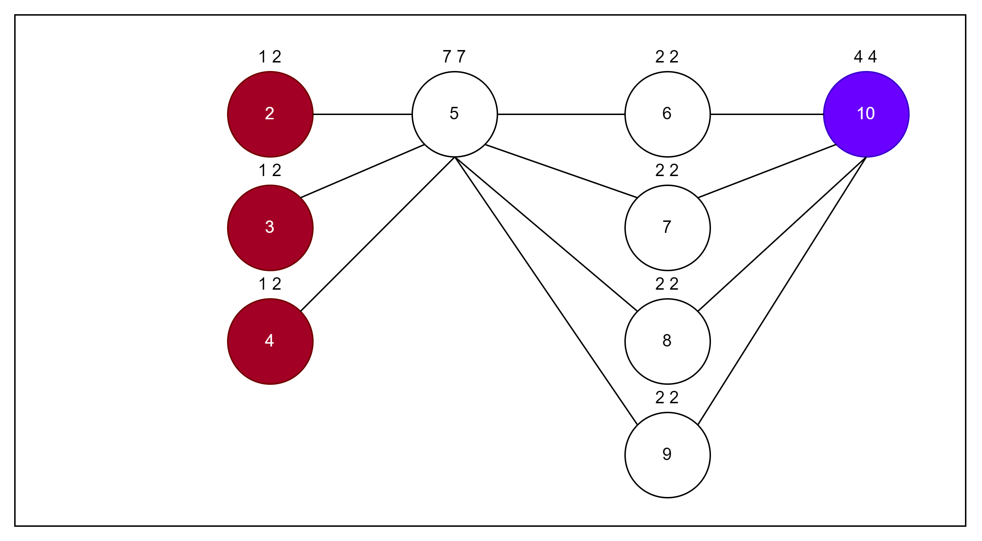
Kahn’s Algorithm – Example 2

Slide 19
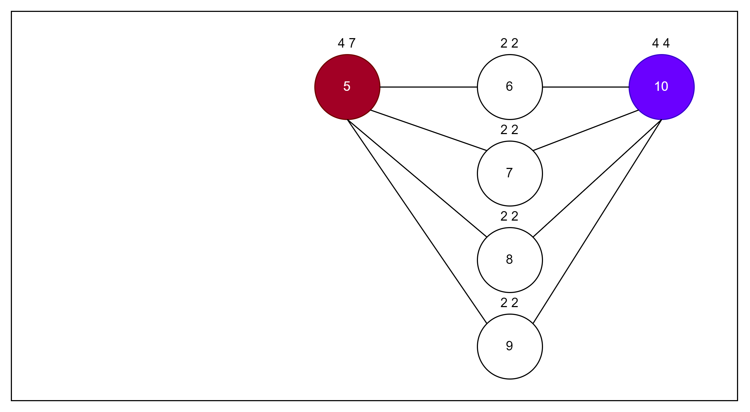
Kahn’s Algorithm – Example 2

Slide 20
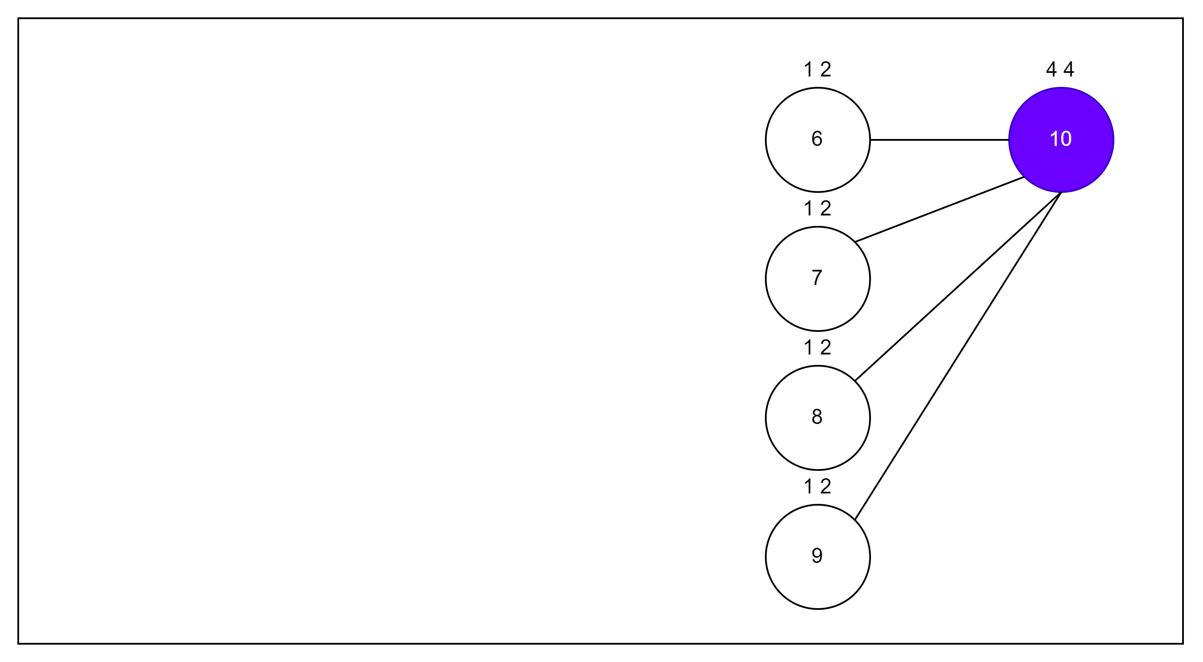
Kahn’s Algorithm – Example 2

Slide 21
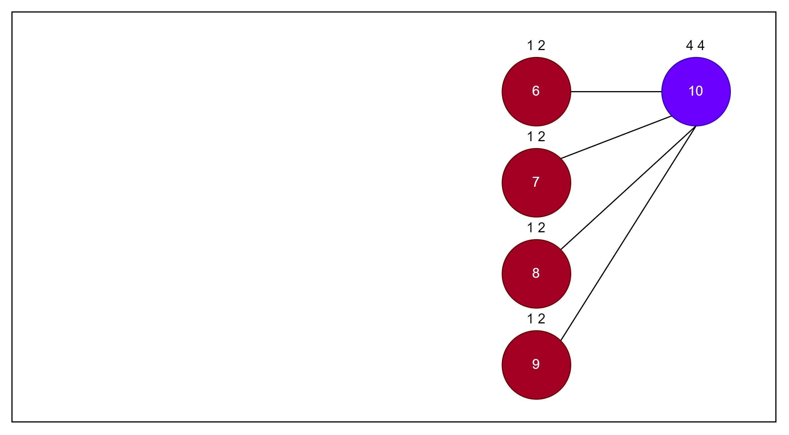
Kahn’s Algorithm – Example 2

Slide 22
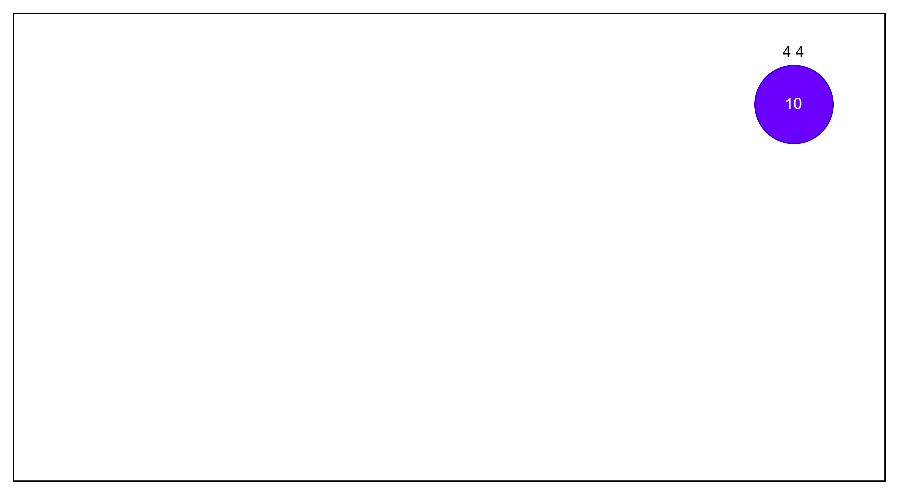
Kahn’s Algorithm – Example 2

Slide 23
Learn by Doing
Task – Brexit – Link.
Solve the task using presented approach.

